Slide 1
Career Readiness Assistance Work Group
Military Transition Demographics
Transitioning Service Members Entering the Workforce in 2021

Slide 2
Retiring
LOCATION | OFFICER COL LTC MAJ | ENLISTED CMS SMS MSG TSG SSG SRA A1C | TOTAL
FLORIDA
NORTHWEST FLORIDA | 26 38 15 | 18 47 152 56 11 6 3 | 372
HURLBURT/EGLIN | 20 36 15 | 12 43 137 48 9 6 3 | 329
TYNDALL | 6 2 0 | 6 4 15 8 2 0 0 | 43
FLORIDA (NON-PANHANDLE) | 19 42 12 | 9 30 77 42 6 2 0 | 239
TOTAL | 45 80 27 | 27 77 229 98 17 8 3 | 611

Slide 3
Separating
LOCATION | OFFICER COL LTC MAJ CPT 1LT 2LT | ENLISTED CMS SMS MSG TSG SSG SRA A1C | TOTAL
FLORIDA
NORTHWEST FLORIDA | 0 0 21 32 3 1 | 0 0 2 17 181 204 5 | 466
HURLBURT/EGLIN | 0 0 20 31 3 1 | 0 0 2 15 156 192 5 | 425
TYNDALL | 0 0 1 1 0 0 | 0 0 0 2 25 12 0 | 42
FLORIDA (NON-PANHANDLE) | 0 1 8 2 3 0 | 2 5 7 10 61 58 6 | 163
TOTAL | 0 1 29 34 6 1 | 2 5 9 27 242 262 11 | 629

Slide 4
Combined Exit
LOCATION | OFFICER COL LTC MAJ CPT 1LT 2LT | ENLISTED CMS SMS MSG TSG SSG SRA A1C | TOTAL
FLORIDA
NORTHWEST FLORIDA | 26 38 36 32 3 1 | 18 47 154 73 192 210 8 | 838
HURLBURT/EGLIN | 20 36 35 31 3 1 | 12 43 139 63 165 198 8 | 754
TYNDALL | 6 2 1 1 0 0 | 6 4 15 10 27 12 0 | 84
FLORIDA (NON-PANHANDLE) | 19 43 20 2 183 0 | 11 35 84 52 67 60 6 | 402
TOTAL | 45 81 56 34 6 1 | 29 82 238 125 259 270 14 | 1240
HURLBURT, EGLIN AND TYNDALL ALONE HOLD 67.58% OF FLORIDA’S VETERANS SEPARATING OR RETIRING.

Slide 5
Top States for USAF Separation
THE STATE OF FLORIDA HOLDS 7.5% OF ALL PEOPLE RETIRING OR SEPARATING IN 2021

Slide 6
Career Field Demographics

Slide 7
Security Clearance
LOCATION | SECRET | TS/SCI | UNDER REVIEW | TOTAL
FLORIDA
HURLBURT/EGLIN | 481 | 269 | 3 | 753
TYNDALL | 59 | 24 | 2 | 85
FLORIDA (NON-PANHANDLE) | 224 | 177 | 1 | 402
TOTAL | 764 | 470 | 6 | 1240
99.7% OF TRANSITIONING MILITARY POSSESS SECRET OR TS/SCI SECURITY CLEARANCES FOR A MINIMUM OF 2 YEARS AFTER

Slide 8
Demographics by Education
LOCATION | SOME COLLEGE | ASSOC | BA | MASTERS | PROF | PhD | TOTAL
FLORIDA
HURLBURT/EGLIN | 354 | 177 | 171 | 122 | 11 | 5 | 840
TYNDALL | 30 | 22 | 19 | 14 | 0 | 0 | 85
FLORIDA (NON-PANHANDLE) | 139 | 114 | 64 | 73 | 3 | 7 | 400
TOTAL | 523 | 313 | 254 | 209 | 14 | 12 | 1240

Slide 9
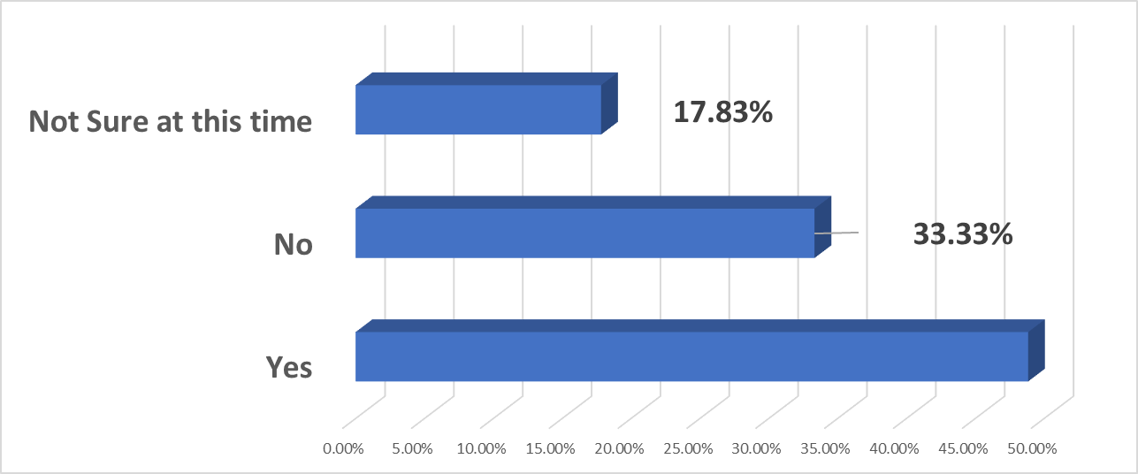
Are you staying in the local area?
48.84%

